Slide 1

Making this resource work for you
Prior to teaching this lesson, please refer to the ‘Unit Overview and Planning Document’.
Further guidance on planning Science Mastery lessons can be found in the detailed planning guidance document.
Refer to the ‘notes’ section on each slide for useful information, including suggested expositions, pedagogical content knowledge, suggested questions, answers and more. Consider using presenter mode so you can see this guidance throughout the lesson.
The introduction slides can be adapted to suit your teaching style and the needs of your class.
Before the lesson, adapt the fix-it slide to address any misconceptions identified in the previous lesson’s exit ticket.
Choose from the suggested activities to suit your class. The intention is not that you complete all of these, but that you select those which ones are most appropriate for your students. It may be appropriate to further adapt activities for your students.
These lessons are designed to occupy approximately 1 hour. To adapt for a shorter or longer lesson duration we advise you to adapt the activity section accordingly.
Please consider using the final slide to send feedback about this lesson or examples of PowerPoints that you have adapted to our design team. Your feedback is used to improve Science Mastery for all of our teachers and students. We appreciate all suggestions and comments.
Thank you for reading!
The Science Mastery Team

Slide 2
Soluble Salts
Answer the questions below.
Copy and complete this general equation for a neutralisation reaction
_______________ + alkali → _______________ + water
Name the products formed when nitric acid reacts with magnesium.
Name the products formed when hydrochloric acid reacts with sodium hydroxide.
What pH range is alkaline?
Link these symbol formulae to the correct names. HCl HNO₃ H₂SO₄
acid
salt
Magnesium nitrate and hydrogen
Sodium chloride and water
pH 8 – pH 14
HNO₃
Nitric acid
Hydrochloric acid
Sulfuric acid
HCl
H₂SO₄
Notes:
Purpose: to assess learning from before the lesson and interleave prior knowledge.
Foundation: Write the general word equation for the reaction between an acid and a metal carbonate.
Stretch: Write a balanced symbol equation for the reaction between hydrochloric acid and sodium hydroxide.
Answers:
Foundation: acid + carbonate → salt + carbon dioxide + water
Stretch: HCl(aq) + NaOH(aq) → NaCl(aq) + H₂O(l)
:

Slide 3
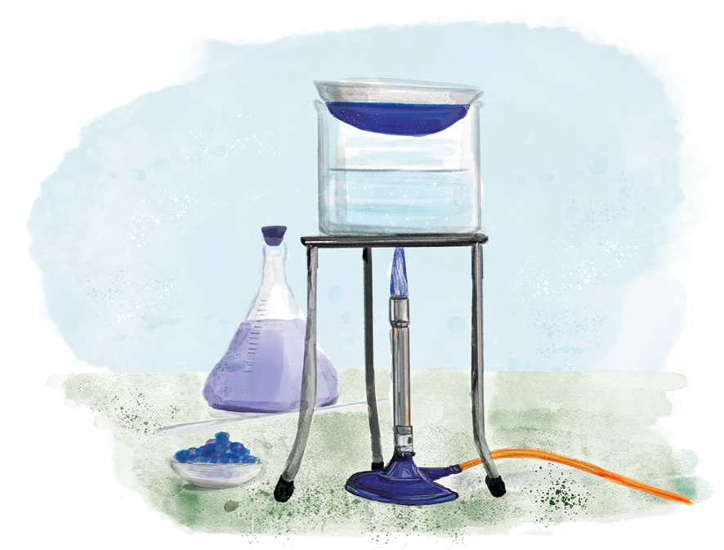

C3.2.9
17/04/2024
Soluble Salts
C3.2.1 Prior Knowledge Review
C3.2.2 Relative Formula Mass
C3.2.3 Percentage by Mass
C3.2.4 Conservation of Mass
C3.2.5 Balancing Equations
C3.2.6 Uncertainty
C3.2.7 Introducing Concentration
C3.2.8 Concentration Calculations
C3.2.9 Soluble Salts
C3.2.10 Making Soluble Salts
C3.2.11 Making Soluble Salts 2
Notes:
This lesson links to the big idea Reactions Rearrange Matter. So far in this unit students have focussed on quantitative chemistry by learning how to calculate relative formula mass, calculate percentage by mass, calculate concentration and balance equations. Now we will recap knowledge from C2.1 Acids and Alkalis and C3.1 Mixtures and apply it in the context of making soluble salts from insoluble bases and acids. The rest of the unit will focus on this key practical which brings together practical skills such as filtration and evaporation with knowledge about neutralisation reactions.
Suggested hook:
Pour about a teaspoon of table salt into a beaker of water (approx. 500 ml) and stir to dissolve it. Where has this salt gone? It has dissolved and a solution has now formed. What is the difference between soluble and insoluble? Soluble substances dissolve in water but insoluble substances do not.

Slide 4

Following this lesson, students will be able to:
Recall the difference between soluble and insoluble salts
Describe dissolving in terms of particles
Describe a chemical reaction to produce a soluble salt
Key Words:
soluble
insoluble
dissolve
base
acid
salt
neutralisation

Slide 5
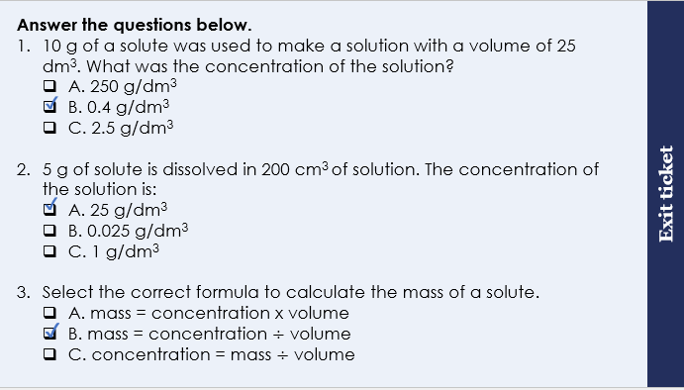
This is the fix-it portion of the lesson
The fix-it is an opportunity to respond to gaps in knowledge, especially those identified by the previous lesson’s exit ticket.
The teacher should customise this slide as needed, to facilitate
reteach, explanation, demonstration or modelling of ideas and concepts that students have not yet grasped or have misunderstood.
practise answering specific questions or of key skills.
redrafting or improving previous work.
Notes:
Purpose: to spend time on any gaps identified in previous learning from exit ticket feedback.
Fix-it guidance from previous exit ticket:
Q1. Answer: B
Answering A suggests that the student has multiplied the mass and volume instead of dividing. Answering C suggests that the student has divided volume by mass instead of the other way around. To fix-it, remind the student of the correct formula to calculate concentration. Model the method to work this calculation out, and then give the student some similar calculations to try.
Q2. Answer: A
Answering B suggests that the student has used the volume in cm³ and has not converted to dm³. Answering C suggests that the student has multiplied he mass and the correct volume, instead of dividing these as needed. To fix-it, remind the student of the correct formula to calculate concentration and the need to convert to dm³. Model the method to work this calculation out, and then give the student some similar calculations to try.
Q3. Answer: B
Answering A or C suggests that the student is having difficulty rearranging the correct equation. To fix-it, reteach how this is done using slides 9 and 10, and give the student some practice calculations to apply this learning.

Slide 6
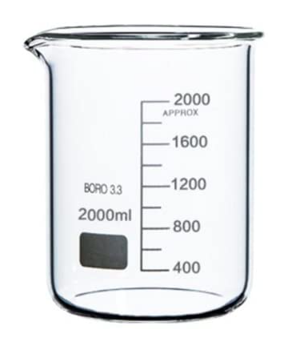
What happens when a soluble substance dissolves?
Before dissolving
After dissolving
Stir
Sugar solution
= a water particle
= a sugar particle
Notes:
Exposition type: Explanation
Suggested teacher exposition:
What happens when a soluble substance dissolves? What is happening to the particles of the solute and the solvent? Take a beaker of water and a sugar cube. Sugar is soluble in water; this means that it will dissolve in water to make a sugar solution. What is the solute in this example? The sugar. What is the solvent in this example? The water. In this particle diagram, the water particles are in blue and the sugar particles are in yellow. How do we know that the sugar is a solid in this diagram? The particles are touching and arranged in a regular pattern. Stir the mixture to dissolve the sugar.
After it has been stirred, the sugar dissolves.
This particle diagram shows the arrangement of particles of the solute and the solvent in the solution. This looks different because each of the 9 the particles of sugar are spread out and mixed throughout the solution. They are no longer in a solid lump, the particles have completely dissolved.
So, a sugar solution has been made. How would the mass change after the sugar had dissolved? It wouldn’t change – because there is the same number of particles before dissolving and after dissolving. How could you separate the water and the sugar to get the sugar back again? Evaporate the water by heating. We will now look at what happens when we mix water with an insoluble substance.
Common misconception
A common misconception here is when students think that the sugar has disappeared after dissolving because it can no longer be seen. Support this by discussing that mass is the same before and after dissolving (see exposition above) and also by looking at the number of particles in the diagrams.
Image from pixabay

Slide 7
Insoluble substances
Stir
= a water particle
= a copper oxide particle
Notes:
Exposition type: Explanation
Suggested teacher exposition:
What would happen if we try to stir an insoluble substance, such as copper oxide, in water? Nothing because it cannot dissolve.
As you can see in the particle diagram. If a substance is insoluble, it will remain solid in the mixture with water. But the particles do not separate and become dissolved in the solution.

Slide 8
Comparing dissolving and melting
Before dissolving
After dissolving
Stir
Ice cubes
Water
Heat
Notes:
Exposition type: Explanation
Suggested guidance:
This purposely stimulates some cognitive conflict to tackle a misconception that a dissolving substance is simply the same as the substance melting.
Suggested teacher exposition:
We will now compare dissolving and melting so that we can be confident that we know the difference between them.
This is the same particle diagram you just saw which shows dissolving
This is a diagram showing 6 solid ice cubes in a beaker which then are heated and melt to form liquid water. The key difference between melting and dissolving is that melting only involves one substance – here it is water. Whereas dissolving involves more than one substance, where the resulting solution is a mixture of both. Another difference is that only soluble salts will dissolve in water, however all salts will melt if they are heated to their melting point. When comparing two things we must also consider the similarities as well as the differences. One way that melting and dissolving are similar is that both are physical changes and no chemical reaction occurs. Another similarity is that both the solid and the soluble substance have a close, regular particle arrangement and then after melting or dissolving, the particles move further apart and become random in arrangement.

Slide 9


Use thumbs up or down to show if each statement is true or false. Rewrite the false statements to make them true.
Melting and dissolving are the same thing.
Soluble salts can dissolve in water.
NaCl (l) means that the NaCl is dissolved in solution.
If something cannot dissolve in water, then it is insoluble.
A solution is a mixture containing a solute dissolved in a solvent.
Melting is the change in state from solid to liquid whereas dissolving is where solute particles disperse throughout the solvent.
(l) = liquid and (aq) = aqueous or in solution
Notes:
Purpose: to check that key knowledge from the introduce phase has been learnt and understood.

Slide 10

Can you explain the difference between these two processes?
Melting
Dissolving
Notes:
Stretch: What is the difference between a salt solution and a molten (melted) salt?
Stretch answer: A salt solution contains the salt particles in water. A molten salt where the solid salt is melted from a solid to a liquid. The liquid in the end will only contain the salt particles, and no water.
Answers:
Melting is the change in state from a solid to a liquid whereas dissolving is a process where solute particles disperse throughout the solvent.
Melting only involves one substance whereas dissolving contains more than one substance, the solute(s) and the solvent.
Melting results in a liquid whereas dissolving results in a solution.
Suggested guidance:
Talk tasks can be used in a variety of ways to suit the particular needs of the students you are teaching. Through exchanging views with others, students develop their understanding of the science beyond what could be achieved individually.
Science classrooms that successfully integrate talk have the following features:
Science talk is a regular feature of lessons and is woven into classroom activities.
Students are paired or grouped strategically by the teacher to ensure productive interaction. This might take into consideration the students’ proficiency of the English language, how encouraging they might be to peers and their attainment in the topic. It’s a good idea to consider these pairings in the class seating plan.
Students are encouraged and supported to talk, but are not forced to talk.
The teacher should take on the role of a facilitator, engaging with conversations where necessary and encouraging or steering the conversation where needed.
Students are encouraged to use the language they have to express their ideas (e.g., everyday language, imperfect English, native language), but also to incorporate science specific terminology where this is more accurate or has been taught.
6. Scientifically inaccurate ideas are not dismissed by the partner or teacher; open discussion and further investigation are relied on to help students construct ideas that support them to progress in their scientific understanding.
7. Guidelines for behaviour during talk tasks are explicit and frequently reviewed. Rules for students might be:
Listen carefully to your partner
Take turns talking.
Speak one at a time, without interrupting.
Politely agree or disagree and explain why.
Politely point out if your partner has used a scientific word incorrectly, if they have explained the science incorrectly, or if there is a more accurate way to describe something.
If confused, ask questions.
Stay focused on the discussion topic.
Respond to one another.

Slide 11
Are all salts soluble?
Is calcium carbonate soluble?
Is potassium sulfate soluble?
Is sodium hydroxide soluble?
Is sodium nitrate soluble?
Soluble in water | Insoluble in water
All nitrates e.g. calcium nitrate
Most sulfates e.g. magnesium sulfate | Lead sulfate, barium sulfate
Most chlorides, bromides and iodides e.g. sodium chloride, sodium bromide, sodium iodide | Silver chloride, silver bromide, silver iodide, lead chloride, lead bromide, lead iodide
Sodium carbonate, potassium carbonate | Most other carbonates
Sodium hydroxide, potassium hydroxide | Most other hydroxides
Yes
Yes
No
Yes
Notes:
Suggested guidance:
Students do not need to memorise this table. They should however be able to use it to state whether a specific salt is soluble or insoluble in water.
Display the table and give students a 20 seconds or so to look at it and interpret the information then ask a student to explain what this is showing.
Go through each row to explain that this table tells us what salts are soluble and insoluble in water. (Saying ‘in water’ is important, as some salts which are soluble or insoluble in water may be not in other solvents, such as alcohol).
Go through some examples with students to check that they can use the table to see if a salt is water soluble or water insoluble. Ask students to justify their answer using the table as you go through each example to ensure they are using the table and not guessing.

Slide 12
Neutralisation reactions review
Acid + alkali → salt + water
Acid + base → salt + water
Alkali – neutralise acid, pH 8 – 14, soluble in water
Base – neutralise acid, pH 8 – 14, soluble or insoluble in water
Acid + metal oxide →
Acid + metal hydroxide →
Acid + metal carbonate →
salt + water
salt + water
salt + water + carbon dioxide
Notes:
Purpose: to recap learning from Y8 C2.1 Acids and Alkalis.
Suggested exposition:
We will now recap the general equation for neutralisation reactions that we learned back in Y8. Read the reactants and question students about the products before revealing them.
In the rest of this unit, and in chemistry more generally, we only refer to alkalis if they neutralise acid, have a pH 8-14 and are soluble in water. There are also substances that neutralise acid, have a pH 8-14 but are insoluble in water. Bases can be either soluble or insoluble, so it is more useful to have the general equation as acid + base. Later we will refer to insoluble bases.
Now we will recap three general word equations for neutralisation reactions. Acid reacts with metal oxides to produce? Salt + water
Acid reacts with metal hydroxides to produce? Salt + water
Acid reacts with metal carbonates to produce? Salt + water + carbon dioxide

Slide 13
I: Identifying soluble salts
Copper oxide and hydrochloric acid react to make a salt.
Name the salt produced.
Use the table below to determine whether this salt is soluble or insoluble.
Copper chloride
Soluble
Soluble in water | Insoluble in water
All nitrates e.g. calcium nitrate
Most sulfates e.g. magnesium sulfate | Lead sulfate, barium sulfate
Most chlorides, bromides and iodides e.g. sodium chloride, sodium bromide, sodium iodide | Silver chloride, silver bromide, silver iodide, lead chloride, lead bromide, lead iodide
Sodium carbonate, potassium carbonate | Most other carbonates
Sodium hydroxide, potassium hydroxide | Most other hydroxides
Yes

Slide 14
We: Identifying soluble salts
Barium hydroxide and sulfuric acid react to make a salt.
Name the salt produced.
Use the table below to determine whether this salt is soluble or insoluble.
Barium sulfate
Insoluble
Soluble in water | Insoluble in water
All nitrates e.g. calcium nitrate
Most sulfates e.g. magnesium sulfate | Lead sulfate, barium sulfate
Most chlorides, bromides and iodides e.g. sodium chloride, sodium bromide, sodium iodide | Silver chloride, silver bromide, silver iodide, lead chloride, lead bromide, lead iodide
Sodium carbonate, potassium carbonate | Most other carbonates
Sodium hydroxide, potassium hydroxide | Most other hydroxides
Yes

Slide 15
You: Identifying soluble salts
Potassium hydroxide and nitric acid react to make a salt.
Name the salt produced.
Use the table below to determine whether this salt is soluble or insoluble.
Potassium nitrate
Soluble
Soluble in water | Insoluble in water
All nitrates e.g. calcium nitrate
Most sulfates e.g. magnesium sulfate | Lead sulfate, barium sulfate
Most chlorides, bromides and iodides e.g. sodium chloride, sodium bromide, sodium iodide | Silver chloride, silver bromide, silver iodide, lead chloride, lead bromide, lead iodide
Sodium carbonate, potassium carbonate | Most other carbonates
Sodium hydroxide, potassium hydroxide | Most other hydroxides
Yes

Slide 16
A soluble salt can be made from an insoluble base in a neutralisation reaction
CuO_{(s)} + H₂SO_{4(aq)} → CuSO_{4(aq)} + H₂O_{(l)}
Solid copper oxide solid
Sulfuric acid solution
Copper sulfate solution
Water
Hydrochloric acid forms -chlorides
Sulfuric acid forms -sulphates
Nitric acid forms -nitrates
Notes:
Purpose: to introduce new learning.
Suggested exposition:
A soluble salt can be made from an insoluble base in a neutralisation reaction. In chemistry, the production of soluble salts from insoluble bases is very important and is used in industry and medicine. We will be carrying out this reaction ourselves next lesson.
Here is an example of how soluble copper sulfate is produced using a neutralisation reaction. Copper oxide is an insoluble base. We know it is solid because of the state symbol.
It reacts with H2SO4, which is sulfuric acid. What pH would you expect sulfuric acid to be? Acidic pHs are from 1-6.
Then the neutralisation reaction produces a soluble salt called copper sulphate. The copper atom has some from the copper oxide and the sulphate SO4 has come from the sulfuric acid. Water is the other product formed. If you had a pure solution of copper sulphate what would you expect the pH to be? pH7
As a recap, you need to know that: read out the box and write in books.
Suggested guidance:
You could show some copper oxide, a black powder, and sulfuric acid, a colourless liquid. Then show them copper sulphate solution, a blue liquid) to support understanding. What would you see as this reaction progresses? The copper sulphate would react with the acid and the black colour would fade, as the solution turns a blue colour. Would there be bubbles? No, because no gas is produced (see state symbols of products).

Slide 17
Drill
What is a soluble salt? What is an insoluble salt? If you add 1 g of sugar to 20 g of water, the sugar dissolves. What would the mass be?
If you see KCl_{(aq)} what does it mean?
What is the difference between melting and dissolving?
What is a soluble base called?
The soluble salt made from insoluble copper oxide and nitric acid is called…
The soluble salt made from insoluble copper oxide and hydrochloric acid is called…
The soluble salt made from insoluble copper oxide and sulfuric acid is called…
How might you make calcium chloride and water?
Notes:
Purpose: This is a knowledge drill. The purpose of this is to check that the critical knowledge is secure before pupils move onto independent practice.
Suggested guidance: There are a range of ways this could be done depending on time and ability range of the class:
Mini whiteboards
As full sentences in exercise books
As short answers in exercise books
In the pupil workbook
As pair talk
As cold call

Slide 18
Drill answers
A salt that can dissolve in water
An insoluble salt is one that cannot dissolve in water 21 grams as the particles have been added together Potassium chloride has dissolved in water Melting when you have a change of state from solid to liquid and dissolving is when a solute’s particles disperses into a solvent
A soluble base is called an alkali Copper oxide and nitric acid make copper nitrate Copper oxide and hydrochloric acid make copper chloride Copper oxide and sulfuric acid make copper sulfate You can make calcium chloride and water by reacting calcium hydroxide and hydrochloric acid
Notes:
Purpose: This is a knowledge drill. The purpose of this is to check that the critical knowledge is secure before pupils move onto independent practice.
Suggested guidance: There are a range of ways this could be done depending on time and ability range of the class:
Mini whiteboards
As full sentences in exercise books
As short answers in exercise books
In the pupil workbook
As pair talk
As cold call

Slide 19
Answer the questions below.
Choose the correct general word equation.
A. Acid + base → salt + water
B. Acid + metal hydroxide → salt + water
C. Both A and B are correct
Nitric acid produces…
A. nitrates.
B. nitrides.
C. nitrites.
Choose the correct reactants that would produce calcium nitrate and water.
A. Calcium hydroxide + hydrochloric acid
B. Calcium + hydrochloric acid
C. Calcium hydroxide + nitric acid
D. Calcium + nitric acid
✓
✓
✓
Notes:
Purpose: to check that key knowledge from the introduce phase has been learnt and understood.

Slide 20
Copy and complete these word equations
Copper oxide + hydrochloric acid → copper chloride + water
Magnesium oxide + sulfuric acid → ________________ + ________________
Potassium hydroxide + nitric acid → ________________ + ________________
Calcium oxide + sulfuric acid → ________________ + ________________
________________ + ________________ → lead chloride + water
____________ + _____________ → copper sulfate + water + carbon dioxide
magnesium sulfate
water
potassium nitrate
water
calcium sulfate
water
Lead oxide or
Lead hydroxide
hydrochloric acid
Copper
carbonate
sulfuric acid
Notes:
Suggested guidance
A possible stretch would be to write balanced symbol equations if the formulae for the reactant bases is given.
CuO
MgO
KOH
CaO
PbO
CuCO3

Slide 21
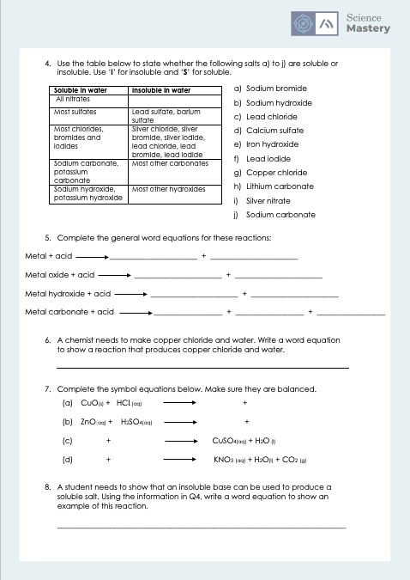
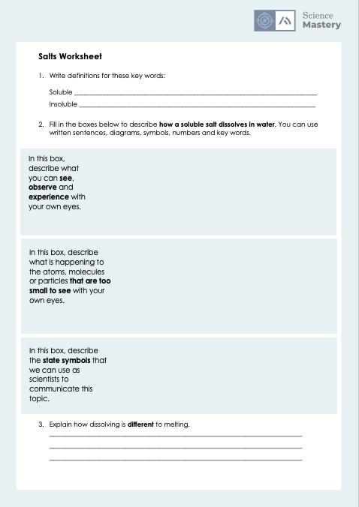
Complete the worksheet
Notes:
The answers to the worksheet are in folder

Slide 22
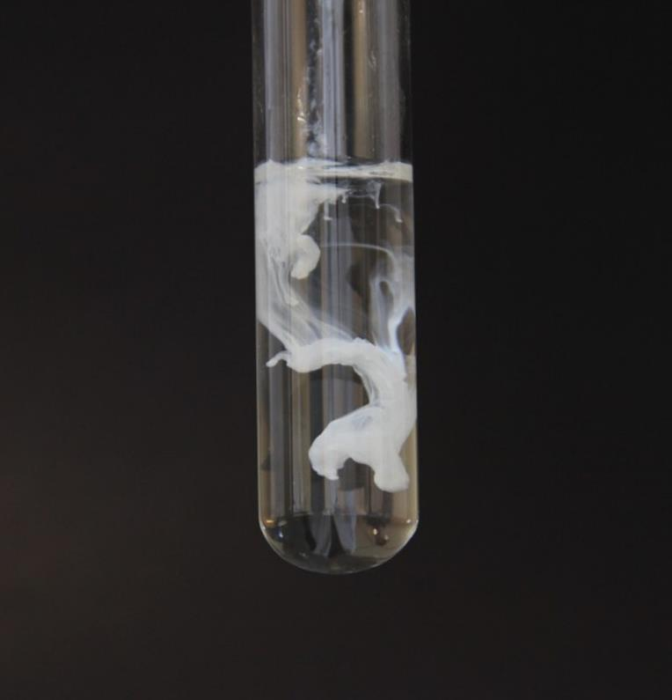
Demonstration: Making an insoluble salt
Watch the demonstration carefully.
Can you name the products of this reaction?
State whether each product is soluble or insoluble.
Silver chloride and sodium nitrate
Silver chloride is insoluble.
Sodium nitrate is soluble.
Notes:
Suggested guidance:
This should be done as a stretch is there is time in the lesson. The worksheet questions should be done first to practice applying the knowledge.
This activity is the precipitation of silver chloride, an insoluble salt, and reinforces the difference between soluble and insoluble salts.
When clear, colourless silver nitrate solution is added to clear, colourless sodium chloride solution, white silver chloride precipitates.
Almost all alkali metal compounds and nitrates are soluble, but most silver compounds are insoluble (except for acetates, perchlorates, chlorates, and nitrates). Therefore, when the soluble salts silver nitrate and sodium chloride are mixed, insoluble silver chloride forms and precipitates out. AgNO₃(aq) + NaCl(aq) --> AgCl(s) + NaNO₃(aq) or Ag⁺(aq) + Cl⁻(aq) --> AgCl(s)
Silver nitrate is used in photography, medicine, silver plating and refining, and in making mirrors and indelible ink.
Apparatus/Chemicals required:
about 500mL 1M sodium chloride solution
dropper bottle of 0.1M silver nitrate solution
glass cylinder
Dark background to help students to see the resulting reaction
Procedure
Place the glass cylinder in front of the background to provide better visibility. The black background works best for this demo. Fill the cylinder about halfway with sodium chloride solution. Add several droppers full of silver nitrate solution to the cylinder. Immediately a white precipitate forms.
Safety Precautions
Silver nitrate is a strong oxidiser, but the solution is fairly dilute. Wear goggles. Avoid getting silver nitrate solution on your skin. If your skin comes into contact with silver nitrate solution, immediately wash thoroughly with soap and water. If you get silver nitrate solution in your eyes, flush with water for 15 minutes and seek medical help. (But don’t panic, this solution is about 1.5% by weight and 1% solution is used to treat eye infections.) It is the responsibility of each individual teacher to risk assess this demonstration for themselves and their class.
Image source
https://commons.wikimedia.org/wiki/File:Silver_chloride_(AgCl).jpg

Slide 23
Answer the questions below.
An insoluble salt…
A. dissolves in water to form a solution.
B. cannot dissolve in water.
C. are alkalis.
Copper sulphate is a salt. Which of the following would not be involved in a reaction to make copper sulfate.
A. Hydrochloric acid
B. Copper oxide
C. Sulfuric acid
Which is true of an aqueous solution of copper sulfate?
A. It is molten (melted) copper sulfate salt
B. It is copper sulfate dissolved in water
C. Answers A and B are the same thing.
✓
✓
✓
Notes:
Q1. Answer: B
If students answer A, this suggests a gap in knowledge about the definitions of insoluble and soluble. To fix-it, reteach this using examples of NaCl being soluble and CuO being insoluble in water. Then ask students to explain the difference between a soluble and insoluble salt.
If students answer C, this suggests a gap in knowledge about the definition of alkalis. To fix-it, reteach that alkalis are bases that are soluble in water and a substance with a pH 8-14 that is insoluble is called a base. Then ask students to write out definitions for base and alkali.
Q2. Answer: A
If students answer B, this suggests a gap in knowledge that copper oxide produces a copper salt. If students answer C, this suggests a gap in knowledge that sulfuric acid produces a sulphate. To fix-it, model using a few example reactions, how different reactants form particular salts (e.g. copper oxide, calcium carbonate and sulfuric acid, hydrochloric acid ). Highlight/underline in different colours to show which elements in the reactants have formed the salt. Then remove and ask students to complete word equations using these same products.
Q3. Answer: B
If students answer A, this suggests a confusion between solutions and molten substances. To fix-it, ask students to write out the definition of aqueous and then ask them to explain why molten copper sulfate is not aqueous.
If students answer C, this suggests the common misconception that dissolving and melting (or a molten substance and a solution) are the same thing. To fix-it, show using particle diagrams the difference between copper sulfate solution and molten copper sulfate. Then ask students to explain the difference between a sodium chloride solution and molten sodium chloride.

Slide 24
Lesson C3.2.9
What was good about this lesson? | What can we do to improve this lesson?
Send us your feedback by clicking this link
or by emailing sciencemastery@arkonline.org
Thank you!

